Slide 1


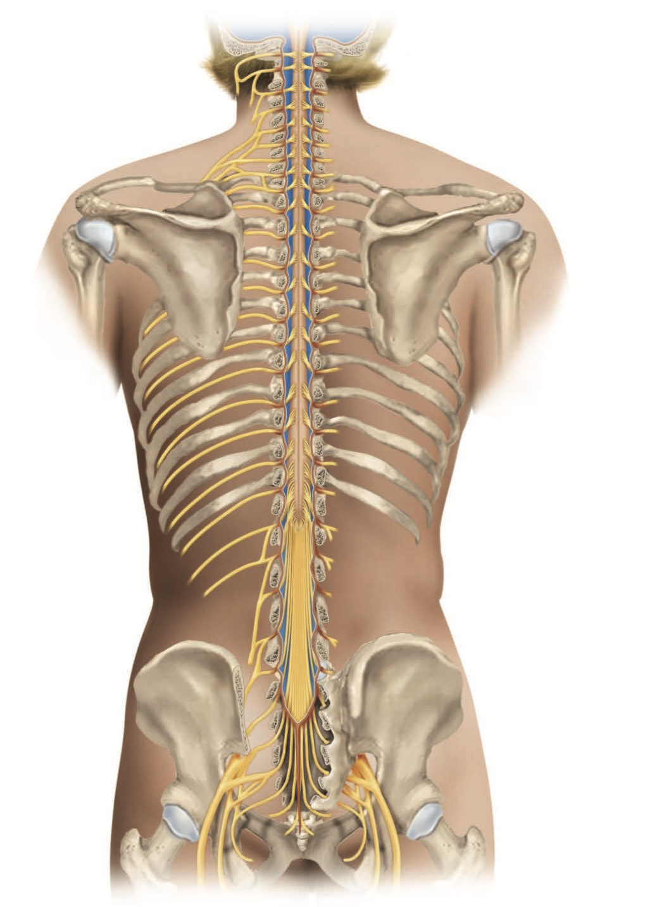
The Nervous System
Al-Farabi Kazakh National University
Higher School of Medicine

Slide 2
Functions and Divisions of the Nervous System
The nervous system has three fundamental functions:
sensory, the ability to respond to stimuli within and around the body, and to generate signals that carry information about those stimuli to the spinal cord or brain;
integrative, the ability to receive and process information, store and retrieve it, and make decisions as to whether or how to respond to it;
and motor, the ability to issue outgoing signals to muscle and gland cells to produce a response.
Al-Farabi Kazakh National University
Higher School of Medicine

Slide 3
Medical terms
erg = work, action after noradrenaline, a synonym for norepinephrine
arachn = spider, spider web; oid = like
pia = through mistranslation, now construed as tender, thin, or soft
endo = within; neuri = nerve
fasc = bundle;
Al-Farabi Kazakh National University
Higher School of Medicine

Slide 4
icle = little
peri = around
epi = upon
gangli = knot
ramus = branch

Slide 5
afferent —Carry or move inward or toward a central structure
In the nervous system, afferent impulses travel toward the central nervous system.
blood–brain barrier —Protective mechanism that blocks specific substances found in the bloodstream from entering delicate brain tissue
efferent —Carry or move away from a central structure
In the nervous system, efferent impulses travel away from the central nervous system.
limbic system —Complex neural system located beneath the cerebrum that controls basic emotions and drives and plays an important role in memory
The limbic system is primarily related to survival and includes such emotions as fear, anger, and pleasure (food and sexual behavior).
ventricle
ventr: belly, belly side -ical: pertaining to — Organ chamber or cavity that receives or holds fluid
In the nervous system, cerebrospinal fluid flows through the ventricles into the spinal cavity and back toward the brain, where it is absorbed into the blood.

Slide 6
Gross Anatomy of Nervous system
The nervous system has two main anatomical subdivisions.
The central nervous system (CNS) is composed of the brain and spinal cord and is enclosed and protected by bone—the cranium and vertebral column. It carries out the integrative functions of the nervous system.
The peripheral nervous system(PNS) is composed of nerves leading to and from the CNS. The PNS provides the CNS with pathways of signal input and output, connecting it to the body’s sense organs, muscles, and glands. Thus, it carries out both the sensory and motor functions.

Slide 8




Peripheral Nervous System (PNS)
Somatic Nervous System
• 12 pairs of cranial nerves
• 31 pairs of spinal nerves
Autonomic Nervous System
Sympathetic Division (fight or flight)
Parasympathetic Division (rest and digest)

Slide 9
Neurons (Nerve Cells)
The agents of communication in the nervous system are neurons (nerve cells).

Slide 10
The Spinal Cord, Spinal Nerves, and Reflexes
The Spinal Cord—Functional Anatomy
Its functions include:
∙ Conduction. It contains bundles of nerve fibers that carry sensory signals from the lower body up to the brain and motor signals down to the muscles and glands below the head.
∙

Slide 11
Neural integration. Pools of spinal neurons integrate information arriving from various sources and execute appropriate output—for example, integrating stretch receptors from the urinary bladder with information from the cerebrum about the appropriate time and circumstances to urinate, and issuing output to the urinary sphincters to either allow or delay urination.

Slide 12
Locomotion. Pools of spinal neurons called central pattern generators control the rhythmic limb movements of locomotion.

Slide 13
Reflexes. Spinal reflexes play vital roles in posture, motor coordination, and protective responses to pain or injury.

Slide 14
The spinal cord extends for about 45 cm (18 in.) from the foramen magnum of the skull to the level of the first or second lumbar vertebra, just below the ribs (farther in infants and children).
It is divided into cervical, thoracic, lumbar, and sacral regions. The last of these is named for the fact that its nerves emerge from the vertebral canal in the sacral region, not because the spinal cord itself extends that far.
The cord averages about 1.8 cm wide (comparable to the little finger), but it widens slightly at the cervical and lumbar enlargements because of the greater mass of neurons here to control the complex movements of the upper and lower limbs.

Slide 15
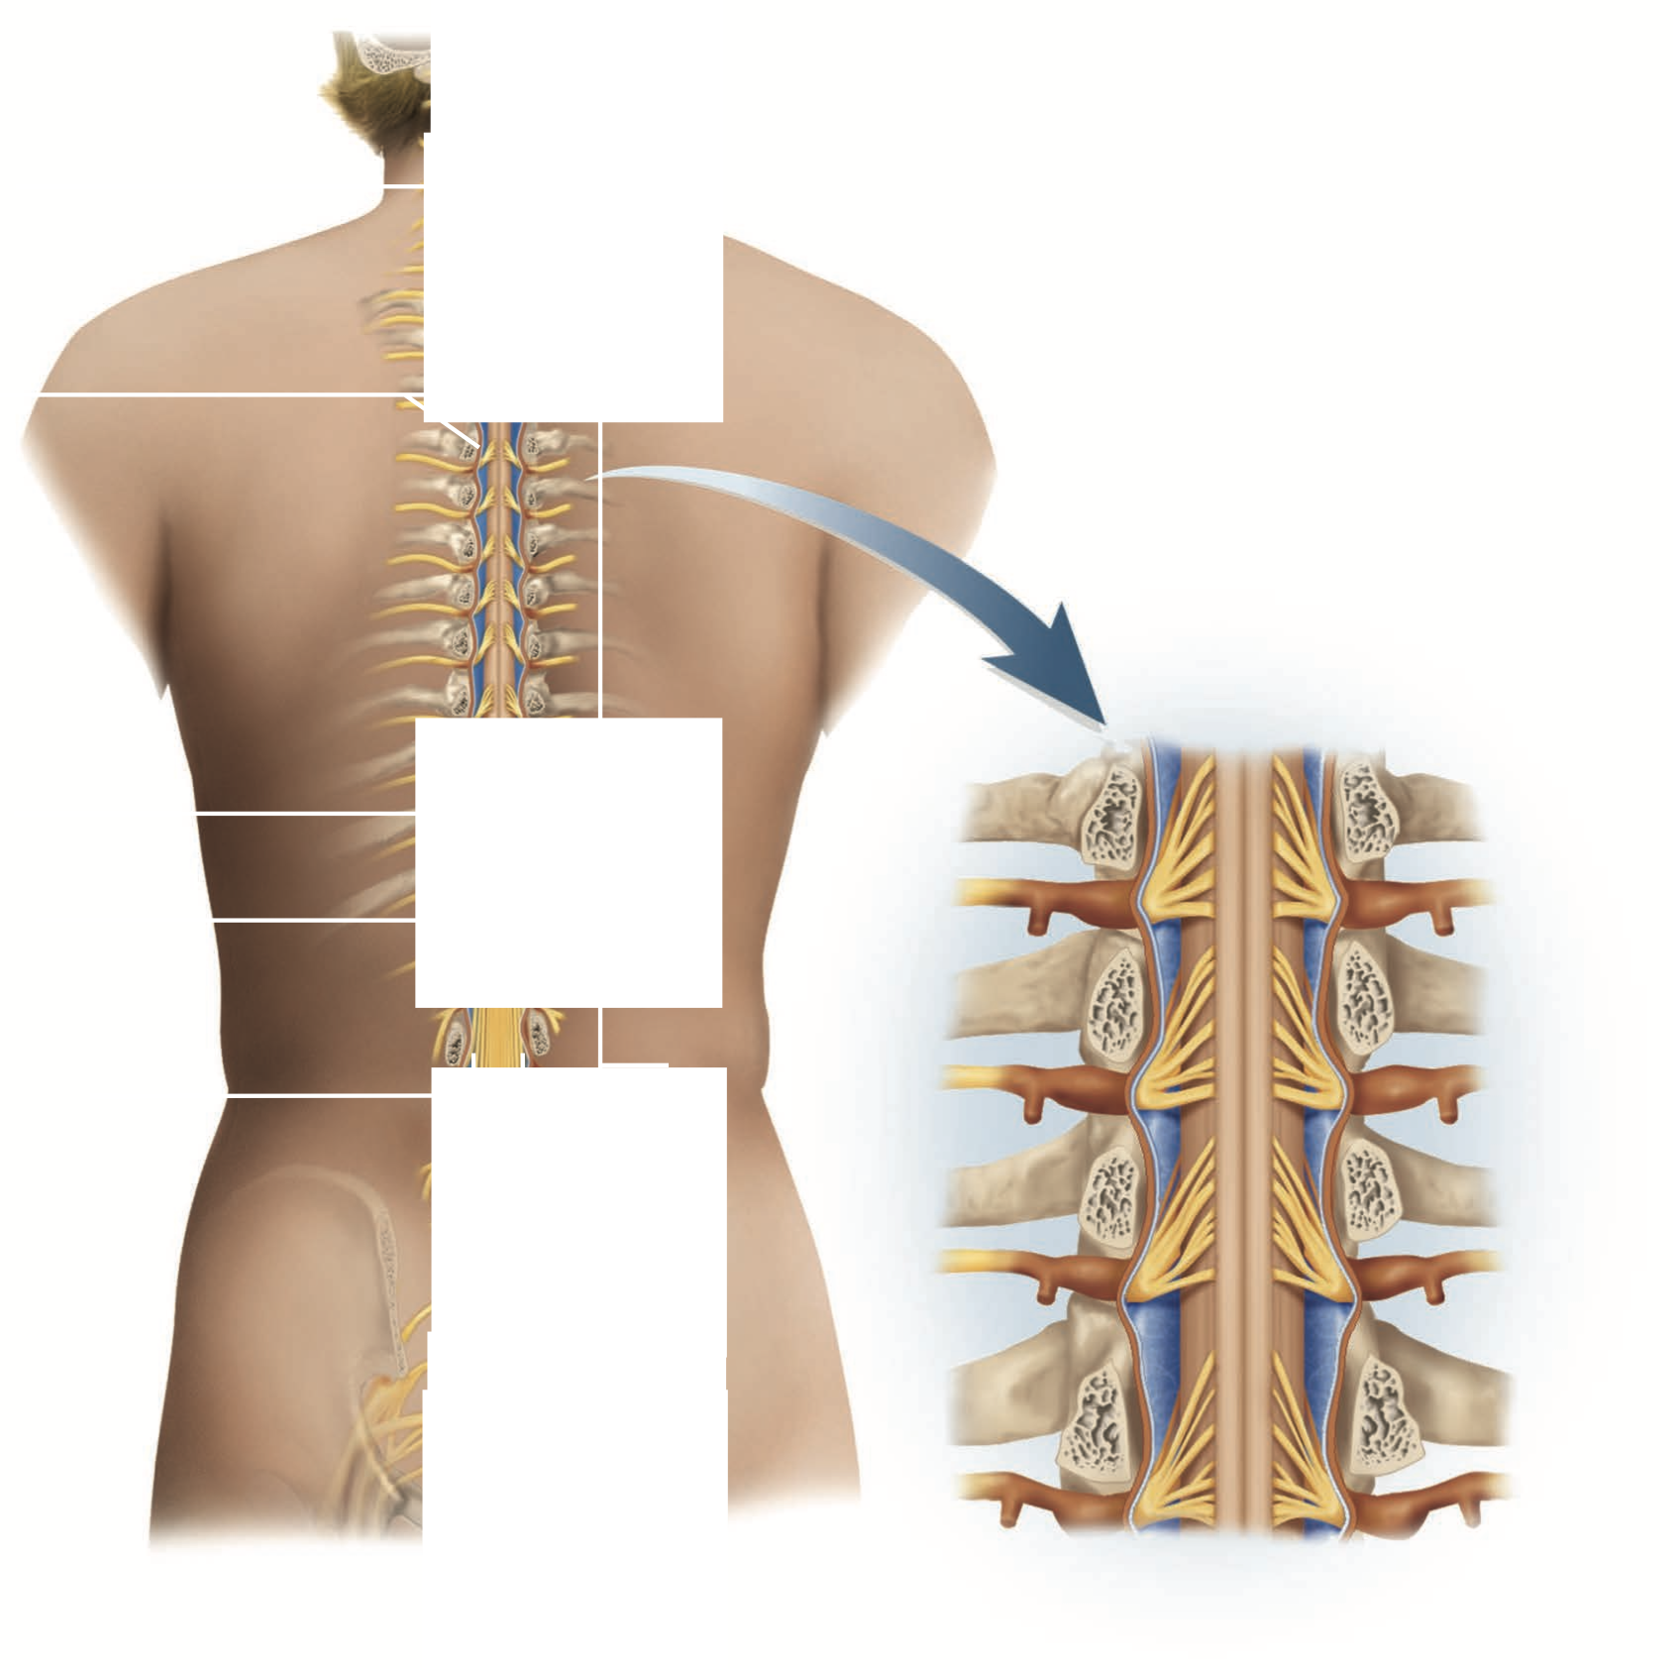

Slide 16
At its lower end, the spinal cord tapers to a blunt point, the medullary cone, and gives off a bundle of nerves that occupy the vertebral canal from there through the sacrum.
This bundle somewhat resembles a horse’s tail and is therefore named the cauda equina.

Slide 17
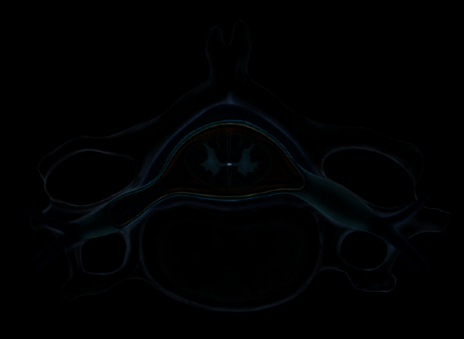
In cross section, the cord is elliptical in shape and exhibits a central butterfly- or H-shaped core of gray matter surrounded by white matter (fig. 8.16).

Slide 18
A pair of median grooves almost divides the cord in half, but they stop short of a gray matter bridge (gray commissure) that connects the right and left halves of the cord.
In the middle of the gray commissure, there is often a central canal filled with cerebro-spinal fluid, but in most regions of the adult spinal cord, the canal is collapsed and closed.

Slide 19
The Spinal Gray Matter
In the gray matter, the two posterior “wings of the butterfly” are called the posterior horns. They extend to the surface of the cord and serve as receiving points for incoming sensory information.
The two anterior wings are called the anterior horns. They are wider than the posterior horns and extend only partially toward the spinal cord surface
From the second thoracic to the first lumbar segment of the cord, there is also a lateral projection of gray matter called the lateral horn, the origin of neurons of the sympathetic nervous system described in section 9.5.

Slide 20
The Spinal White Matter
The white matter of the spinal cord consists of bundles of nerve fibers traveling up and down the cord, serving as communication pathways between different levels of the body. Some of these fibers originate from brain neurons, and others from neurons in the gray matter of the cord. These bundles of nerve fibers are arranged in three groups on each side of the cord—posterior, lateral, and anterior columns.

Slide 21
A functional knowledge of these columns is crucial in understanding spinal cord injuries, because often a patient loses specific sensory or motor abilities depending on which column, and which of its subdivisions, has been injured. Each column is divided into functionally distinct tracts of white matter. Some of them are ascending tracts that carry sensory information to higher levels of the cord and the brain. Others are descending tracts that carry motor signals from the brain down the cord to meet the motor neurons that control muscles and glands.
Such crossing-over is called decussation.¹⁷

Slide 22
The Spinal Meninges—Protective Membranes
The brain and spinal cord are covered by three membranes that lie between the nervous tissue and bone (fig. 8.16b). They help to protect the delicate nervous tissue from abrasion and other trauma. Collectively, they are called meninges (men-IN- jeez) (singular, meninx). Individually, they are
1. The dura mater, a tough collagenous membrane about as thick as a rubber kitchen glove. This is the outermost membrane. It lies against the inner surface of the bone in the cranial cavity, but in the vertebral canal it forms a loose-fitting dural sheath around the spinal cord and is separated from the bone by a fat-filled epidural space. Anesthetics are often introduced into this space to deaden the pain of childbirth or surgery (epidural anesthesia).

Slide 23
The arachnoid mater , a delicate middle layer named for an appearance suggestive of a spider’s web. It consists of a thin epithelium adhering to the inside of the dura and a loose web of fibers extending inward to the pia.
The pia mater,theinnermostlayer,atransparenttissue of microscopic thinness that closely follows the surface contours of the brain and spinal cord.

Slide 24
Spinal Nerves—Communicating with
the Rest of the Body
The peripheral nervous system is composed of two kinds of structures: nerves and ganglia.

Slide 25
Each nerve fiber in a nerve is wrapped in a thin layer of loose connective tissue called the endoneurium (fig. 8.17).
In most nerves, the fibers are gathered in bundles called fascicles, each wrapped in a sheath of flat, epithelium- like cells called the perineurium.
Several fascicles are then bundled together and wrapped in an outer, fibrous sleeve called the epineurium to compose the nerve as a whole. The tough epineurium protects the nerve from stretching and injury.

Slide 26
The spinal cord gives off 31 pairs of spinal nerves, emerging with ladderlike regularity from the intervertebral foraminae between the vertebrae.
They provide a means for the cord, and therefore the whole CNS, to communicate with the rest of the body.

Slide 27
Each spinal nerve originates from the cord as six to eight nerve rootlets emerging from the posterior horn of the cord and a similar number arising from the anterior horn

Slide 28
The anterior ramus differs from one region of the trunk to another. In the thoracic region, it forms an intercostal nerve that travels between the ribs, innervating the intercostal muscles, skin, and abdominal muscles. Everywhere else, anterior rami from multiple spinal nerves join each other to form a web of nerves called a plexus.
There are five of these: a small cervical plexus deep in the neck;
a large brachial plexus near the shoulder;
a lumbar plexus in the lower back;
and below that, a sacral plexus and finally a tiny coccygeal plexus.
The nerves that emerge from these plexuses supply the skin, muscles, and other structures at their respective regions of the trunk and issue nerves to the limbs. Figure 8.18 shows a general view of these plexuses, and table 8.1 summarizes the structures innervated by each one.

Slide 30
Structures Innervated by the Spinal Nerve Plexuses
Plexus | Structures Innervated
Cervical plexus | Sensory: Skin of external ear and from surrounding region of head and neck, underside of chin, and shoulder; anterior chest, diaphragm, pleurae, and pericardium Motor: Diaphragm and a few muscles associated with larynx and hyoid bone
Brachial plexus | Sensory: Skin, muscles, and joints of shoulder and upper limb Motor: Muscles of upper limb
Lumbar plexus | Sensory: Skin of lower abdominal, gluteal, and genital regions; skin, muscles, and joints of lower limb Motor: Muscles of abdominal and pelvic regions and thigh
Sacral and coccygeal plexuses | Sensory: Skin of gluteal and perineal regions; genitals; skin, muscles, and joints of gluteal region and lower limb Motor: Muscles of gluteal and perineal regions and lower limb

Slide 31
The Reflex Arc
Somatic reflexes usually involve a relatively simple neural pathway called a reflex arc. Figure 8.19 illustrates the essential components of an arc:
A receptor, a sensory nerve ending or simple sense organ in the skin, a muscle, or a tendon.
An afferent (sensory) nerve fiber, the axon of a unipolar neuron that carries signals from the receptor to the spinal cord or brainstem.
An integrating center, a point of synaptic contact between neurons in the gray matter of the spinal cord or brainstem. In most reflex arcs, this involves one or more interneurons, but in the simplest arcs, the afferent fiber may synapse directly with the efferent fiber. These simple arcs allow for quicker but less complex or refined responses.

Slide 32
An efferent (motor) nerve fiber, which carries motor signals to a skeletal muscle.
An effector, which in this case is the skeletal muscle. In reflexes in general, effector means any organ or cell that carries out the final response.

Slide 33
Somatic Reflexes
A reflex may be defined as a quick, involuntary, stereotyped reaction of a gland or muscle to stimulation. This definition sums up four important properties: (1) Reflexes are quick, usually involving simple neural pathways with relatively few interneurons and little synaptic delay. (2) They are involuntary, meaning they occur without our intent, often without our awareness, and they are difficult or impossible to suppress. (3) They are stereotyped, meaning they occur in essentially the same way every time, unlike our more variable voluntary and learned behaviors. (4) They require stimulation; they are not spontaneous actions like muscle tics but responses to sensory input.
Some reflexes involve cardiac muscle, smooth muscle, or glands, such as accel- eration of the heartbeat in fear, contraction of the esophagus in swallowing, or the secretion of tears in response to irritation of the cornea. These are called visceral reflexes and are discussed in section 9.5. Other reflexes involve skeletal muscles, such as pulling your hand back from a hot stove or the knee-jerk reflex so often evoked in a medical examination. These are called somatic reflexes and are the type we’ll discuss here. They are sometimes called spinal reflexes, but this is a mislead- ing expression because (1) many visceral reflexes also involve the spinal cord, and (2) many somatic reflexes are mediated more by the brain than by the spinal cord.

Slide 34
The Stretch Reflex
The workings of a reflex arc can be exemplified most simply by considering the test so commonly performed in routine medical examinations, the patellar tendon (“knee-jerk”) reflex (fig. 8.19). The doctor taps on the patellar ligament just below the kneecap with a rubber reflex hammer. This stretches the ligament and its continuation, the quadriceps tendon leading to the quadriceps femoris muscle of the thigh. At the junction between the muscle and tendon, and less abundantly elsewhere in the muscle, are specialized stretch receptors called muscle spindles. The sudden stretch produced by the hammer excites the spindle’s nerve fibers, which conduct signals to the spinal cord.

Slide 35
The Flexor Reflex
Another well-known reflex is the flexor (withdrawal) reflex, which occurs, for example, when you pull back your hand upon burning your fingers, or your leg when you’ve stepped on something sharp (fig. 8.20). The protective function of this reflex requires more than the quick jerk and return to normal that we see in the stretch reflex; it requires the coordinated action of multiple muscles and a more sustained contraction so you don’t put your hand or foot right back in harm’s way. The flexor reflex also involves a polysynaptic reflex arc.

Slide 36
For example:
A crossed- extension reflex causes you to stiffen one leg when you lift the other from the ground, so you don’t fall over when withdrawing a limb from pain.
An intersegmental reflex arc travels up and down the spinal cord, from one segment to another, to produce reactions at a level different from the one where the stimulus is received; an example of such a reaction is tilting your torso to the left when you raise the right leg, in order to keep your balance.
A tendon reflex inhibits excessive muscle contractions to prevent the rupturing of tendons.

Slide 37
Test
Testing Your Recall
Myelinated nerve fibers produce action potentials only at their
a. nodes of Ranvier. b. internodes.
c. synapses.
d. dendrites.
e. terminal arborizations.
The posterior root ganglion next to the spinal cord contains the somas of
a. efferent neurons.
b. interneurons.
c. unipolar neurons. d. multipolarneurons. e. motor neurons.
An oligodendrocyte serves CNS nerve fibers in the same way that a/an ________ serves PNS nerve fibers.
a. schwann cell
b. microgliacell
c. endoneurium d. ependymalcell e. satellite cell
An action potential begins with
a. a flow of K⁺ out of a neuron.
b. aflowofCa²⁺intoaneuron.
c. the release of a neurotransmitter. d. a flow of Na⁺ out of a neuron.
e. a flow of Na⁺ into a neuron.
A synaptic vesicle is a storage site for a. calcium ions.
b. sodiumions.
c. neurotransmitter receptors.
d. neurotransmitter.
e. acetylcholinesterase.

Slide 38
  6) The spinal cord is divided into all of the following regions
  except
  a. sacral.
  b. coccygeal. c. lumbar.
  d. cervical. e. thoracic.
  7. Neurons that carry sensory information to the spinal cord are called
  a. efferent neurons. b. effluentneurons. c. interneurons.
  d. affluentneurons. e. afferent neurons.
8. The nerve fibers that stimulate skeletal muscles below the neck arise from neurosomas in
a. the posterior horn.
b. theanteriorhorn.
c. the lateral horn.
d. theposteriorrootganglion. e. the brain.
9. A bundle of nerve fibers within a nerve is called a. the gray matter of the nerve.
b. anendoneurium.
c. a fascicle.
d. thewhitematterofthenerve. e. a perineurium.
10. Jerking your hand back when you are burned is an example of a. an alarm reflex.
b. astretchreflex.
c. decussation.
d. avisceralreflex.
e. a monosynaptic reflex.

Slide 39
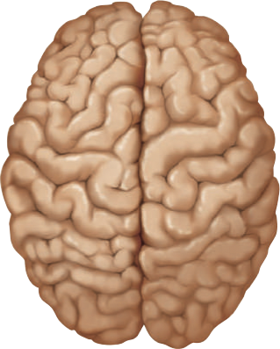
The Nervous System II
THE BRAIN, CRANIAL NERVES, AND AUTONOMIC NERVOUS SYSTEM

Slide 40
Medical term
cereb = brain;
ellum = little
foli = leaf
medulla = pith, inner core;
oblongata = elongated
pons = bridge
ped = foot; uncle = little
substantia = substance; nigra = black
coll = hill; cul = little
thalamus = chamber, inner room
cortex = bark, rind

Slide 41

Major Landmarks
A broad overview of the brain’s gross anatomy will provide important points of ref- erence as we progress through a more detailed study. The largest, most conspicuous part of the brain is the cerebrum, composed of a pair of half-globes called the cerebral hemispheres (fig. 9.1). The cerebral surface is marked by thick folds called gyri (gyrus) separated by shallow grooves called sulci (sulcus). The left and right hemispheres are separated by a very deep groove, the longitudinal fissure. At the bottom of this fissure, the hemispheres are connected by a prominent bundle of nerve fibers called the corpus callosum—a conspicuous landmark in the bisected brain.
grooves called sulci² (SUL-sye; singular, sulcus). The left and right hemispheres are separated by a very deep groove, the longitudinal fissure. At the bottom of this fissure, the hemispheres are connected by a prominent bundle of nerve fibers called the corpus callosum³—a conspicuous landmark in the bisected brain (fig. 9.2)

Slide 42
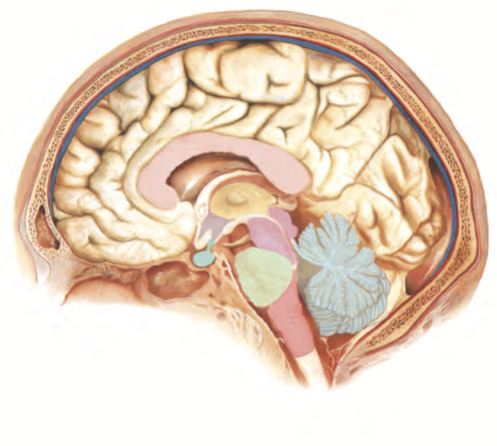
(1) Cerebrum
(2) Corpus callosum
Pons
) Cerebellum
Medulla

Slide 43
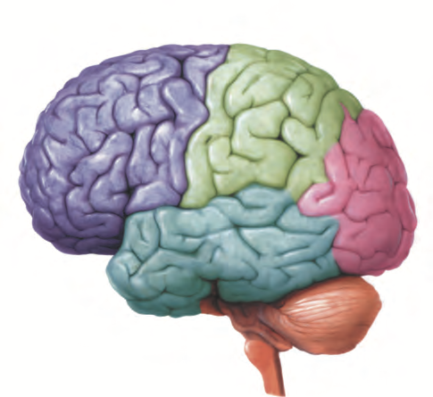
Parietal lobe
3) Frontal lobe
Occipital lobe
Temporal lobe
Cerebellum

Slide 44
The cerebellum is the second-largest part of the brain. It lies at the rear of the head beneath the cerebrum. Like the cerebrum, it is composed of right and left hemispheres. It is marked by slender gyri, here called folia, separated by shallow sulci.
The third major part of the brain is the brainstem, the smallest of all and yet least dispensable to survival.
At the foramen magnum of the skull, the brainstem connects to the spinal cord.

Slide 45

Meninges
the brain is enveloped in three connective tissue membranes, the meninges
dura mater,
arachnoid mater
pia mater.

Slide 46

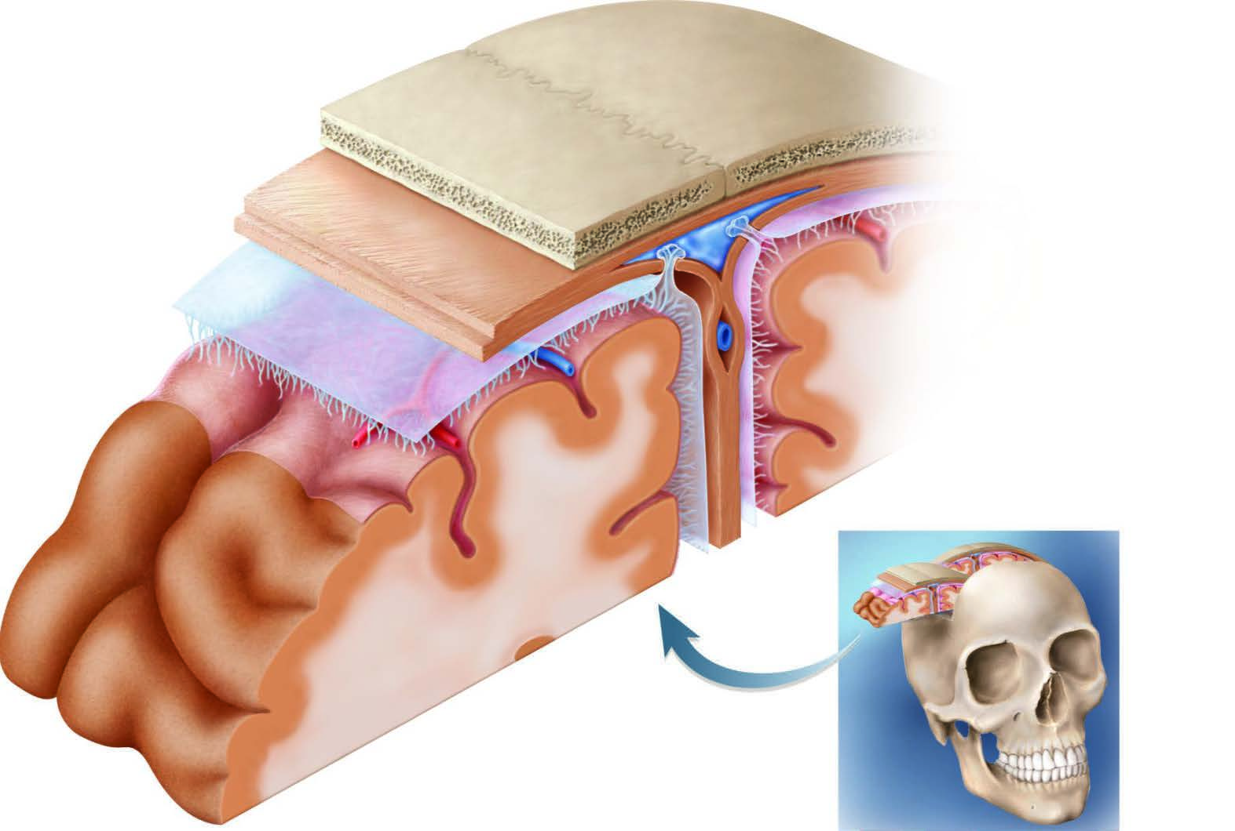
Skull
Dura mater
Arachnoid granulation
Arachnoid mater
Blood vessel
Pia mater
Brain:
Gray matter White matter
Subdural space
Subarachnoid space
Dural sinus

Slide 47
Gray and White Matter
The tissues of the brain are divided into gray and white matter, like those of the spinal cord. In the brain, however, most of the gray matter is on the surface, where it forms a layer called the cortex of the cerebrum and cerebellum (fig. 9.4c). Smaller masses of gray matter called nuclei occur more deeply, surrounded by white matter. The gray matter contains the cell bodies, dendrites, and synapses of the neurons, so it is the site of all information processing, memory, thought, and decision making by the brain. The white matter is composed of tracts (bundles) of myelinated nerve fibers connecting one region of the CNS to another. The afore- mentioned corpus callosum is the largest tract. Tracts get their glistening white color from the myelin.

Slide 48
Ventricles and Cerebrospinal Fluid
Sections through the brain reveal four internal chambers called ventricles —two lateral ventricles, one in each cerebral hemisphere; a single third ventricle in a narrow space between the hemispheres; and a fourth ventricle between the cerebellum and brainstem.
A small pore connects each lateral ventricle to the third, and a canal through the brainstem connects the third ventricle to the fourth.
The system then continues into the spinal cord as the central canal. These chambers and canals are filled with cerebrospinal fluid (CSF), which also fills the subarachnoid space and bathes the external surface of the brain and spinal cord.

Slide 49

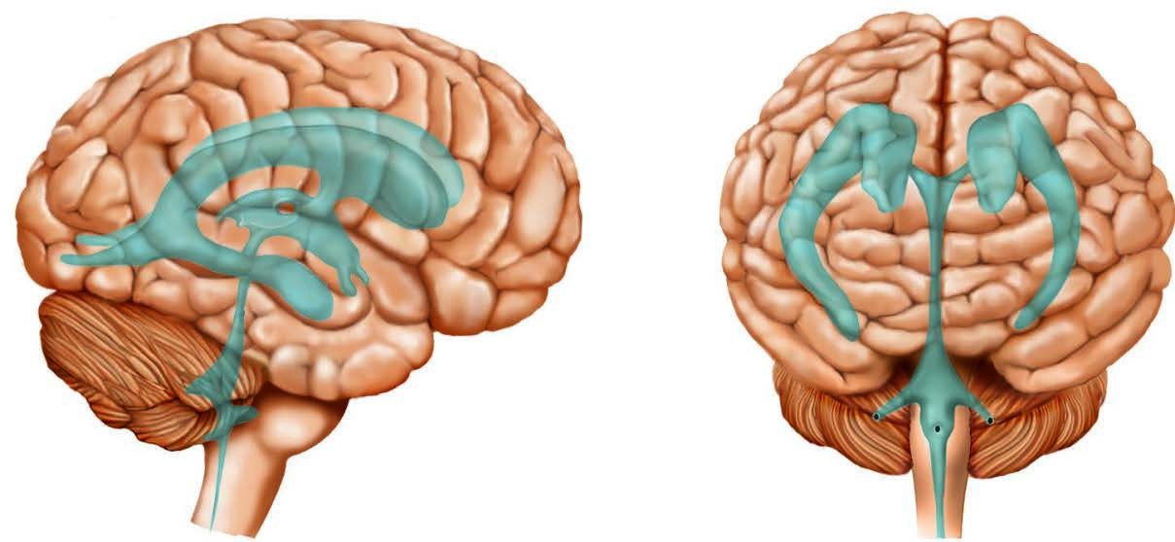
Lateral ventricles
Third ventricle
Fourth ventricle
Central canal

Slide 50
Blood Supply and the Blood–Brain Barrier
The brain is only 2% of the body weight, yet it has such a high metabolic rate that it demands 15% of the blood supply. A mere 4-minute cessation of cerebral blood flow can cause irreversible brain damage.
It receives its supply through two internal carotid arteries that begin near the angle of the mandible and enter the cranial cavity through the carotid foramina in the base of the skull, and two vertebral arteries that pass up the back of the neck through the transverse foramina of the cervical vertebrae and enter the cranial cavity through the foramen magnum.

Slide 51
Despite its critical importance to the energy-hungry brain, the blood is also a source of antibodies, toxins, and other agents that are potentially harmful to the irreplaceable brain tissue.
Consequently, there is a blood–brain barrier (BBB) that strictly regulates what substances can get from the blood- stream into the tissue fluid of the brain.
The BBB consists mainly of tight junctions between the epithelial cells of the cerebral blood capillaries.

Slide 52
Principal Divisions of the Brain
The Brainstem
The brainstem (fig. 9.5) is an elongated pillar of nervous tissue extending vertically from the foramen magnum to the cerebrum.
From inferior to superior, it consists of the medulla oblongata, pons, midbrain, and diencephalon (although not all authorities include the diencephalon).
The brainstem serves in part as the “information highway” between the cerebrum and the lower body; it contains prominent tracts of nerve fibers carrying signals coming up from the spinal cord and down from the cerebrum.

Slide 53
The Medulla Oblongata
The medulla oblongata⁶ looks superficially like a slightly wider continuation of the spinal cord. It contains fiber tracts that carry sensory information from the spinal cord to higher levels of the brain, and motor commands from higher brain centers to the spinal cord. The motor signals travel predominantly through a pair of anterior ridges called pyramids, shaped somewhat like two parallel baseball bats. When you consciously will your muscles to contract, the motor signals pass through here. Ridges on the posterior surface of the medulla carry sensory signals destined for the cerebrum.

Slide 55
The Pons
The pons⁷ (pronounced “ponz”) is a distinctly wider segment of the brainstem superior to the medulla. It is the most significant relay center for signals going to the cerebellum.
It also contains nuclei concerned with sleep, hearing, equilibrium, taste, eye movements, facial expressions, facial sensation, respiration, swallowing, bladder control, and posture.

Slide 56
The Midbrain
The midbrain is a relatively short bridge between the pons and higher brainstem centers. It has a pair of stalks called cerebral peduncles and another pair called cerebellar peduncles that anchor the cerebral hemispheres and cerebellum to the brainstem; these are major communication pathways between these brain regions. The midbrain filters pain stimuli and determines whether we become consciously aware of pain and how intensely we feel it. It also has a darkly pigmented tissue called the substantia nigra, a dark gray to black nucleus pigmented with melanin.
The substantia nigra produces the neurotransmitter dopamine, which acts on the basal nuclei of the cerebrum (described later) to inhibit unwanted muscular movements. Degeneration of the substantia nigra results in the tremors and other motor deficiencies of Parkinson disease.
The posterior surface of the midbrain has four conspicuous humps called colliculi concerned with certain visual and auditory reflexes and other functions related to vision and hearing.

Slide 57
The Diencephalon
The diencephalon consists of a large ovoid mass on each side of the brain called the thalamus, a median funnel-shaped structure called the hypo- thalamus, and a median tissue called the epithalamus above them. Authorities vary on whether they consider the diencephalon to be part of the brainstem.
A thalamus¹¹ underlies each cerebral hemisphere, perched at the superior end of the brainstem. In about 70% of people, the right and left thalami are joined medially by a narrow bridge of tissue.
The thalamus plays various roles in memory, emotion, motor control, and sensation. Its main function is to process incoming sensory information and relay it to the appropriate places in the cerebrum.

Slide 58
A single hypothalamus, as its name implies, lies medially beneath the thalami. It is shaped somewhat like a flattened funnel, forming the floor and the lateral walls of the third ventricle. The hypothalamus is a major control center for many instinctive and automatic functions of the body including water balance, blood pressure, hunger and thirst, digestive functions, metabolism, stress responses, shivering and sweating, sleep, memory, growth, emotion, reproductive cycles, sexual behavior, childbirth, and lactation. The pituitary gland attaches by a stalk to the base of the hypothalamus, and the hypothalamus carries out several of its functions by regulating the secretion of pituitary hormones.
The epithalamus is a small median sliver of tissue that arches over the midline between the thalami. Its most prominent component is the pineal gland, an endocrine gland that produces melatonin and serotonin

Slide 59
The Cerebellum
The cerebellum is the second-largest part of the brain. Even though it is only 10% of the brain mass, it contains over 50% of its neurons. As noted earlier, the cerebellum consists of right and left hemispheres connected by a narrow bridge, and is marked by slender folia and sulci. The cerebellum has a surface cortex of gray matter and a deeper layer of white matter. In a sagittal section, the white matter exhibits a branching, fernlike pattern called the arbor vitae

Slide 60
The Cerebrum
The cerebrum is the largest and most conspicuous part of the brain. It enables you to turn pages in a book, read and comprehend the words, remember ideas, talk about them, and take an examination. It is the seat of your sensory perception, memory, thought, judgment, and voluntary motor control, among other functions.

Slide 61
Lobes of the Cerebrum
There are five lobes in each hemisphere, mostly named for the overlying cranial bones (fig. 9.7):
1. The frontal lobe begins immediately behind the frontal bone, superior to the eyes. Its posterior boundary is a wavy vertical groove, the central sulcus, that extends from the top of the head to the margin of the lateral sulcus, which is described shortly. A wide region of the frontal lobe just anterior to the central sulcus is concerned with voluntary motor functions. Farther anterior to this, between the motor region and the forehead, is the prefrontal cortex. This is little developed in other mammals but very prominent in humans, and is concerned with explicit memory (memory of facts that you can verbalize), mood, emotion, motivation, and abstract thought such as foresight, planning, problem solving, and social judgment.On the underside of each frontal lobe is a club-shaped olfactory bulb, which receives nerve fibers from the nose for the sense of smell and relays these signals to more posterior processing centers.

Slide 62
The parietal lobe forms the uppermost part of the brain and underlies the parietal bone. Its anterior boundary is the central sulcus and its posterior boundary is the parieto–occipital sulcus, visible on the medial surface of each hemisphere (see fig. 9.2). This lobe is concerned with the sensory perception and integration of taste; processing visual information; spatial perception; language processing; numerical awareness (such as how many objects one is seeing); and somatic (body-wall and musculoskeletal) sensa- tions such as touch, stretch, and pain.
Theoccipitallobeisattherearoftheheadunderlyingtheoccipitalbone.It is the principal visual center of the brain.
The temporal lobe is a lateral, horizontal lobe deep to the temporal bone, separated from the parietal lobe above it by a deep lateral sulcus. It is con- cerned with hearing, smell, emotional behavior, learning, various aspects of memory, visual recognition, and language comprehension.
The insula¹⁵ is a small mass of cortex deep to the lateral sulcus, made vis- ible only by retracting or cutting away some of the overlying cerebrum (see figs. 9.1c, 9.4c, and 9.7). It plays roles in taste, pain, visceral sensations (such as a stomachache), consciousness, emotion, empathy, and cardiovas- cular homeostasis.

Slide 63
The Basal Nuclei
The basal nuclei are masses of cerebral gray matter buried deep in the white matter, lateral to the thalamus (see fig. 9.4). They receive input from the substantia nigra of the midbrain and motor areas of the cerebral cortex and send signals back to both of these locations. They are part of a feedback loop that serves in motor control and are further discussed in a later section on that topic.

Slide 64
The Limbic System
The limbic¹⁶ system is a group of brain structures concerned primarily with learn- ing, memory, and emotion. It forms a ring of tissue on the medial side of each hemisphere, encircling the corpus callosum and thalamus (fig. 9.8). It includes con- nections to other parts of the brain, including portions of the frontal and temporal lobes, hypothalamus, thalamus, and the olfactory apparatus. The last of these may explain why certain odors are associated with powerful memories and emotional responses. Two particularly important components of the limbic system are the amygdala¹⁷ (ah-MIG-da-luh) and hippocampus¹⁸—both of which are parts of the temporal lobe.
The limbic system was originally thought to be associated mainly with smell, but later experiments revealed more significant roles in emotion and memory. It is involved in feelings that reinforce behaviors important to survival, such as the sense of reward associated with eating and sex, fear upon seeing a snake, and aversion to a food that has made one sick in the past.

Slide 65
Sensation
The human senses fall into two categories:
(1) The special senses employ sense organs limited to the head and include vision, hearing, equilibrium, taste, and smell.
(2) The somatosensory or general senses are distributed over the entire body and include touch, itch, pain, heat, cold, pressure, stretch, and movement. The regions of the brain that receive input for the special senses are
∙ vision—the posterior occipital lobe;
∙ hearing—the superior temporal lobe;
∙ equilibrium—mainly the cerebellum;
∙ taste—parts of the insula and lower parietal lobe; and
∙ smell—the medial surface of the temporal lobe and inferior surface of the
frontal lobe.
These receiving areas are called primary sensory areas. They merely make one aware of a stimulus, but identifying and making sense of it are carried out by adjacent sensory association areas of the cerebrum. For example, a visual associa- tion area immediately anterior to the primary visual area enables one to identify what one sees and to relate effectively to one’s visual world.

Slide 66
Cognition
Cognition refers to mental processes such as awareness, perception, thinking, knowledge, and memory. It is an integration of information between the routes of sensory input and motor output.
Cognitive association areas of the cerebrum account for 75% of our brain tissue. They include the sensory association areas just described, but the earlier discussion also pointed out other, diverse cognitive functions in all five lobes of the cerebrum and even in the cerebellum.
Lesions in these areas can produce a broad spectrum of effects such as inability to recognize familiar faces or to navigate within a familiar building; a variety of language deficits (aphasias) described later; or profound personality disorders and socially inappropriate behaviors.
Memory is one of the cognitive abilities we value most highly. It is a widely distributed function, not localized to any one area of the brain. The creation of new memories from ongoing sensory experience, called memory consolidation, is a function of the hippocampus, amygdala, and cerebellum, but these are not memory-storage depots.

Slide 67
Motor Control
(b)
Components of the nervous system that control the skeletal muscles are called the somatic motor division. This is distinguished from the visceral motor (autonomic) division, discussed later, which controls cardiac and smooth muscle. The somatic motor division is under voluntary control—we contract most skeletal muscles at will—whereas the visceral motor division is involuntary.
The decision to make a voluntary muscular movement originates in the motor association area of the frontal lobe (fig. 9.10a). A “plan of action” is then relayed to neurons in the precentral gyrus—the most posterior gyrus of the frontal lobe, immediately in front of the central sulcus. From neurons of this gyrus, axons descend the brainstem and spinal cord to synapse with motor (efferent) neurons whose axons exit the CNS and supply the skeletal muscles. Most of these axons cross over to the other side of the body as they pass through the medulla oblongata. Consequently, the right cerebrum controls movements on the left side of the body and vice versa. This is not true of most head–neck muscles, however, which are controlled by the cerebral hemisphere on the same side of the body.
The precentral gyrus, like the postcentral gyrus described earlier, has an upside- down map of the opposite side of the body. This is depicted as a motor

Slide 68
The cerebellum aids in learning motor skills, maintains muscle tone and posture, smooths muscle contractions, coordinates eye and body movements, and coordinates the motions of different joints with each other (such as the shoulder and elbow in pitching a baseball).
The cerebellum monitors the body’s position and movements by means of input from the inner ears and sense organs called proprioceptors in the muscles and joints.
It compares the body’s actual movements with our cerebral intentions and issues output that adjusts and smooths out our movements.

Slide 69
Language
Language includes several cognitive and motor abilities—reading, listening, under- standing words, writing, and speaking—involving multiple areas of the cerebrum. The cerebral control of these tasks is very complex, and we can consider only a few key centers here. One is the Wernicke area, usually found in the left cerebral hemisphere just posterior to the lateral sulcus. Immediately posterior to this is a fold of cerebrum called the angular gyrus, which some authorities consider part of the Wernicke area itself.
These areas lie at a crossroad between the visual cortex of the occipital lobe and the auditory cortex of the temporal lobe. They receive input from both and interpret visual images and sounds in terms of learned rules of grammar and vocabulary. That is, they create linguistic meaning from what we see and hear, and they begin to formulate the phrases of what we will speak.

Slide 70
The Wernicke area transmits a plan of speech forward to the Broca area, which lies low in the prefrontal cortex of the same hemisphere (usually the left). The Broca area also plays a part in constructing grammatically sensible sentences, and it compiles a “plan” of motor neuron action that will soon govern the muscle contractions of the larynx, tongue, cheeks, and lips. It transmits this plan by way of the insula to the primary motor cortex (precentral gyrus), which then issues commands to the relevant muscles to carry out the speech. Injury to the Wernicke or Broca area from stroke or trauma can leave a person with language impairments called aphasia.

Slide 71
Cerebral Lateralization
The two cerebral hemispheres look identical at a glance, but close examination reveals a number of differences.
For example, in women the left temporal lobe is often longer than the right. In left-handed people, the left frontal, parietal, and occipital lobes are usually wider than those on the right. The two hemispheres also differ in some of their functions.

Slide 72
The brain communicates with the rest of the body through two routes: the spinal cord and 12 pairs of cranial nerves.
The cranial nerves are numbered I to XII starting with the most anterior pair.
Each nerve also has a descriptive name such as optic nerve or vagus nerve.
Most of these nerves arise from the base of the brain, exit the skull through its foramina, and lead to muscles and sense organs located mainly in the head and neck.

Slide 73
The Cranial Nerves
Number and Name | Function | Anatomical Course
I. Olfactory | Sensory: Smell | From nasal cavity to olfactory bulbs of brain
II. Optic | Sensory: Vision | From eye to thalamus and midbrain
III. Oculomotor | Motor: Eye movements | From midbrain to all muscles of eye movement except as noted for cranial nerves IV and VI; muscle that opens eyelid; and internal eye muscles that control lens and iris
IV. Trochlear | Motor: Eye movements | From midbrain to superior oblique muscle of eye movement
V. Trigeminal (three branches, V₁, V₂, V₃) | Motor: Chewing Sensory: Touch, temperature, and pain from face | Motor: From pons to masseter, temporalis, and pteryoid muscles of chew- ing; tensor tympani muscle of middle ear Sensory: From facial skin, surface of eye, nasal mucosa, paranasal sinuses, palate, teeth and gums, tongue (but not taste buds), floor of mouth, and dura mater to pons
VI. Abducens | Motor: Eye movements | From pons to lateral rectus muscle of eye movement
VII. Facial | Motor: Facial expression; secretion of tears, saliva, and nasal and oral mucus Sensory: Taste | Motor: From pons to muscles of facial expression, salivary glands, tear glands, and glands of nasal cavity and palate Sensory: From taste buds of anterior tongue to thalamus
VIII. Vestibulocochlear | Motor: Cochlear tuning Sensory: Hearing and equilibrium | Motor: From pons to cochlea of inner ear Sensory: From cochlea, semicircular ducts, and vestibule of inner ear, to medulla oblongata and medulla–pons junction
IX. Glossopharyngeal | Motor: Salivation, swallowing, gagging Sensory: Taste; sensations of touch, pressure, pain, and temperature in tongue and outer ear; regulation of blood pressure and respiration | Motor: From medulla oblongata to salivary glands, glands of tongue, and muscle of pharynx Sensory: From middle and outer ear, posterior one-third of tongue (includ- ing taste buds), and pharynx, to medulla oblongata
X. Vagus | Motor: Swallowing, speech, regulation of heart rate and bronchial airflow, gastrointestinal secretion and motility Sensory: Taste; sensations of hunger, fullness, and gastrointestinal discomfort | Motor: From medulla oblongata to tongue, palate, larynx, lungs, heart, liver, spleen, digestive tract, kidney, and ureter Sensory: From root of tongue, pharynx, larynx, epiglottis, outer ear, and several thoracic and abdominal viscera, to medulla oblongata
XI. Accessory | Motor: Swallowing; head, neck, and shoulder movements | From spinal cord segments C1 to C6, into the cranial cavity and back out to palate, pharynx, trapezius, and sternocleidomastoid muscles
XII. Hypoglossal | Motor: Tongue movements | From medulla oblongata to muscles of tongue

Slide 75
The Autonomic Nervous System
The autonomic nervous system (ANS) can be defined as a motor nervous system that controls glands, cardiac muscle, and smooth muscle. It is also called the visceral motor division to distinguish it from the somatic motor division that controls the skeletal muscles.
The primary targets of the ANS are organs of the thoracic and abdominal cavities, such as the heart, lungs, digestive tract, and urinary tract, but it also innervates some structures of the body wall, including cutaneous blood vessels, sweat glands, and piloerector muscles.

Slide 76
Visceral Reflexes
The ANS works through visceral reflexes, which regulate such primitive functions as blood pressure, heart rate, body temperature, digestion, and many others.
In short, the ANS quietly manages a myriad of unconscious processes responsible for our homeostasis; these are not specifically human but among our most basic animal functions.
Many drug therapies are based on manipulation of autonomic functions.

Slide 77
A visceral reflex arc includes the same basic components as a somatic reflex arc —receptors, afferent neurons, interneurons, efferent neurons, and effectors.
For example, high blood pressure activates a baroreflex involving the following components :
1 It stimulates stretch receptors called baroreceptors in the internal carotid arteries and aorta.
2 They issue signals through afferent fibers in the glossopharyngeal nerves to the medulla oblongata.
3 Interneurons of the medulla integrate this input with other information and issue signals back to the heart by way of efferent fibers in the vagus nerves.
4 The vagus nerves slow down the heart (the effector) and reduce blood pressure. This completes a homeostatic negative feedback loop and ideally restores blood pressure to normal.

Slide 78
Neural Pathways
The ANS has components in both the central and peripheral nervous systems. In the CNS, there are autonomic control centers in the hypothalamus and other regions of the brainstem, and motor neurons in the spinal cord.
PNS components include motor neurons in the ganglia and nerve fibers in the cranial and spinal nerves you have already studied.
The autonomic pathway to a target organ differs significantly from somatic motor pathways.
The first neuron, called the preganglionic neuron, has a soma in the brainstem or spinal cord;

Slide 79
Subdivisions of the ANS
The ANS has two subdivisions: sympathetic and parasympathetic.
The sympathetic division adapts the body in many ways for physical activity—it increases alertness, heart rate, blood pressure and flow, blood glucose concentration, and pulmonary airflow.
Extreme sympathetic responses are often called the “fight-or-flight” reaction because they come into play when an ani- mal must attack, defend itself, or flee from danger.

Slide 80
Anatomy of the Sympathetic Division
All efferent, preganglionic fibers of the sympathetic division arise from the thoracic and first two lumbar segments of the spinal cord. These fibers travel a short distance to ganglia that lie alongside the vertebral column.
Here, some of the fibers turn and travel up or down to higher and lower ganglia, uniting the ganglia into a string called the sympathetic chain.
The chain extends upward into the cervical region and downward to the sacral and coccygeal levels.

Slide 81
Another component of the sympathetic division is found in the adrenal glands, which lie superior to the kidneys. The inner core of each gland, the adrenal medulla, is essentially a sympathetic ganglion.
Preganglionic fibers penetrate through the cortex and terminate on cells of the medulla, which secrete epinephrine (adrenaline) and norepinephrine (nor- adrenaline) into the blood.
These hormones accentuate the effects of the sympathetic division.

Slide 82
Anatomy of the Parasympathetic Division
Preganglionic fibers of the parasympathetic division leave the CNS by way of four cranial nerves—the oculomotor (III), facial (VII), glossopharyngeal (IX), and vagus (X) nerves—and by way of spinal nerves from the sacral segments of the spinal cord. In comparison to sympathetic preganglionic fibers, parasympathetic preganglionics travel relatively long distances to terminal ganglia in or near their target organs, and synapse there with short postganglionic fibers that complete the path to the target cells.
Parasympathetic fibers in cranial nerves III, VII, and IX supply target organs in the head, such as tear glands, salivary glands, nasal glands, and internal muscles of the eyeball (for control of the iris and lens).

Slide 83
Anatomy of the Parasympathetic Division
Cranial nerve X (the vagus nerve), however, carries 90% of all parasympathetic fibers and descends through the thorax and abdomen to reach numerous organs in these body cavities—heart, lungs, esophagus, stomach, intestines, liver, pancreas, and urinary tract.
Parasympathetic fibers from the sacral region of the spinal cord supply the colon and rectum, urinary bladder, and reproductive organs.
Fibers from the vagus and sacral nerves pass through various nerve plexuses (webs) on their way to the target organs.

Slide 84
Neurotransmitters and Receptors
We have already seen a few cases in which the two divisions of the ANS have contrasting effects on the same organs. The sympathetic division accelerates the heart- beat, for example, and the parasympathetic division slows it down; the sympathetic division inhibits digestion and the parasympathetic division stimulates it. The key to such contrasting effects, and to many drug actions, depends on differences in the neurotransmitters employed by the two divisions and in the types of neurotransmitter receptors found in the target cells. A single neurotransmitter can excite some organs and inhibit others because of differences in the type of receptor those organs have for it.

Slide 85
Neurotransmitters and Receptors
The two main neurotransmitters employed in the ANS are acetylcholine (ACh) and norepinephrine (NE). A cholinergic nerve fiber or receptor is one that, respectively, secretes or binds ACh. An adrenergic nerve fiber or receptor secretes or binds NE; it is named for an older synonym for NE, adrenaline.
All preganglionic fibers of the ANS are cholinergic; they release ACh to stimulate the postganglionic neurons. Parasympathetic postganglionic fibers also are cholinergic, whereas most sympathetic postganglionic fibers are adrenergic.

Slide 86
Dual Innervation
Many organs receive both sympathetic and parasympathetic input. In the eye, for example, the iris receives fibers of both types (fig. 9.18). Sympathetic fibers dilate the pupil, a well-known sympathetic effect, whereas parasympathetic fibers constrict it. When the two divisions of the ANS have opposite effects on the same organ, they are said to have antagonistic effects.
In other cases, the two divisions have cooperative effects. Saliva, for example, consists of a watery solution of digestive enzymes plus slippery mucus that makes food easier to swallow. Sympathetic fibers stimulate mucus secretion, and parasym- pathetic fibers stimulate enzyme secretion.

Slide 87
Higher-Level Regulation of the ANS
Even though autonomic means “self-governed,” the ANS is not an independent nervous system. All of its output originates in the CNS, and it is strongly influenced by the cerebral cortex, hypothalamus, limbic system, medulla oblongata, and spinal cord.
Consequently, our emotions affect such autonomic functions as blood pressure, heart rate, digestion, and sexual function.
Other autonomic responses originate in the brainstem or are at least influenced by it, such as thermoregulation, salivation, digestive secretion, bladder and bowel control, and pupillary light reflexes.

Slide 88
Clinical Application 9.1
MENINGITIS
Meningitis—inflammation of the meninges—is one of the most serious dis- eases of infancy and childhood. It is caused by a variety of bacterial and viral infections of the CNS. These usually invade by way of the nose and throat, often following respiratory, throat, or ear infections. Meningitis can cause swelling of the brain, cerebral hemorrhaging, and sometimes death within mere hours of onset. Signs and symptoms include high fever, stiff neck, drowsiness, intense headache, and vomiting. Death can occur so suddenly that infants and children with a high fever should receive immediate medical attention. Freshman college students show a slightly elevated incidence of meningitis, especially those living in crowded dormitories rather than off campus.

Slide 89
Post-test:10 min

Slide 90
Post test
The right precentral gyrus controls muscles on the left side of the body because the motor nerve fibers decussate as they pass through
a. the pyramids of the medulla oblongata.
b. the posterior horn of the spinal cord.
c. the corpus callosum between cerebral hemispheres.
d. the white matter of the cerebral hemisphere.
e. the tracts of the spinal cord.
All of the following except the nerve begin or end in the orbit.
a. optic
b. oculomotor c. trochlear
d. abducens e. accessory
The medulla oblongata plays a direct role in all of the following except
a. speech.
b. respiration.
c. swallowing. d. theheartbeat. e. memory.

Slide 91
Movement disorders are most likely to result from injury to
a. the Wernicke area. b. thecerebellum.
c. the prefrontal cortex. d. thetemporallobe.
e. the postcentral gyrus.
To smile, frown, or blow a kiss depends most on which of the following cranial nerves?
a. accessory
b. glossopharyngeal
c. trigeminal d. facial
e. trochlear
Most parasympathetic nerve fibers travel through
a. the corpus callosum.
b. thoracicspinalnerves.
c. sacral spinal nerves. d. thevagusnerve.
4.All of the following except the nerve begin or end in the orbit.
a. optic
b. oculomotor c. trochlear
d. abducens e. accessory
5. The right and left cerebral hemispheres are connected to each other by a thick C-shaped tract of fibers called the .
6. The brain has four chambers called filled with fluid.
7. On a sagittal plane, the white matter of the cerebellum exhibits a branching pattern called the .
8. Acetylcholine binds to a category of neurotransmitter receptors called receptors.

